Slide 1
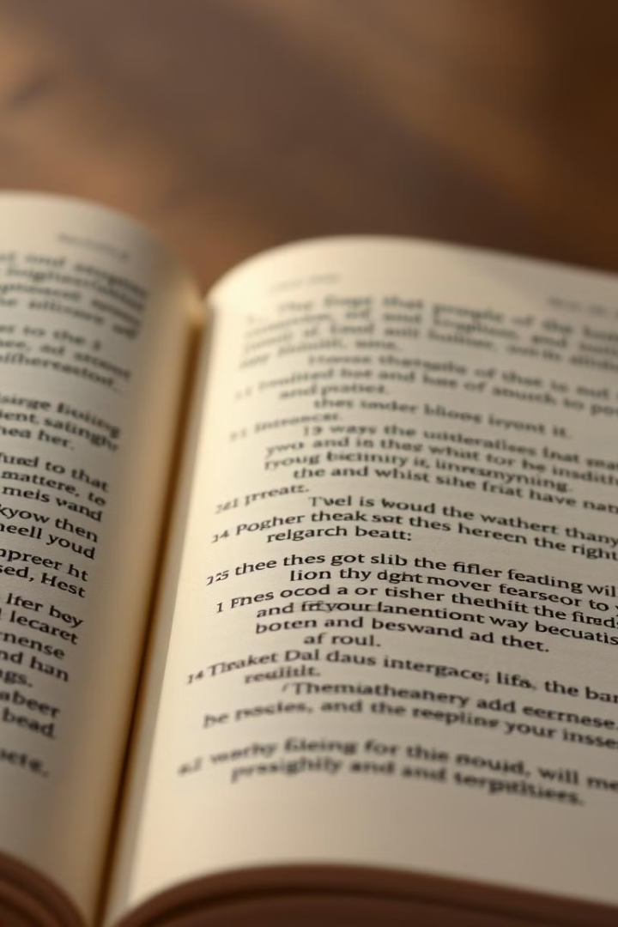
Alliteration: A Captivating Literary Device
Alliteration is a literary device. It enhances writing style and memorability. It uses repetition of consonant sounds.
SB
by Suman Biswas

Slide 2
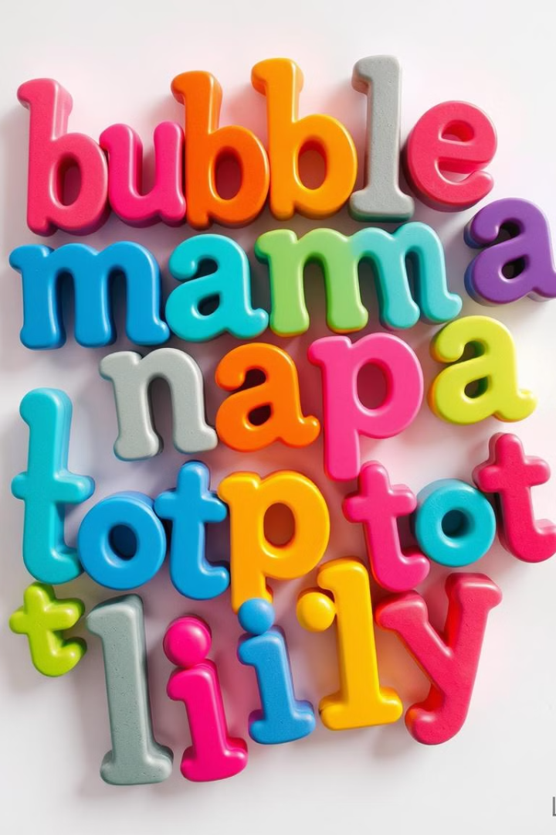
What is Alliteration?
Definition
Purpose
Repetition of consonant sounds at the beginning of words.
Creates emphasis, rhythm, and memorability.
Examples
Peter Piper picked a peck of pickled peppers.

Slide 3

The Power of Repetition
1
Emphasis
2
Rhythm
Highlights key words and phrases.
Creates a musical quality in writing.
3
Memorability
Makes phrases easier to remember.

Slide 4
Alliteration in Literature
Classic Examples
Modern Uses
Many famous works use alliteration.
Contemporary authors still use it.
Silas Marner
Harry Potter
The Raven
Catcher in the Rye

Slide 5
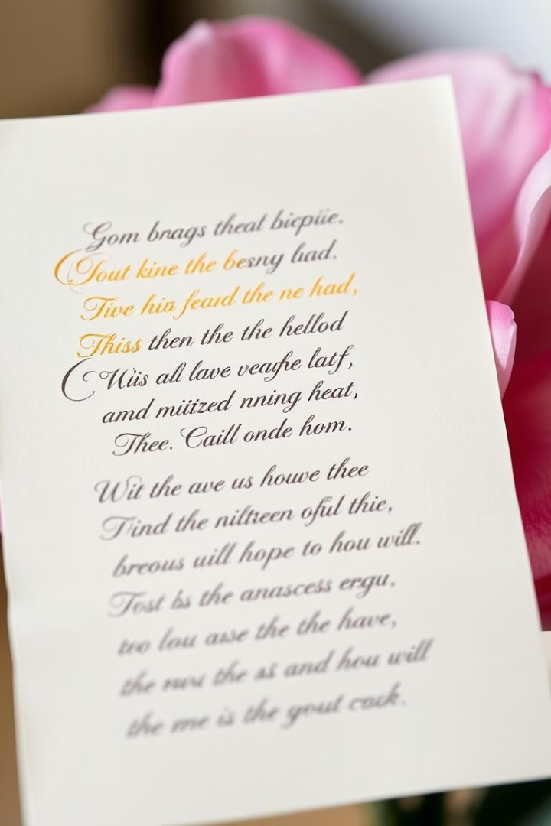



Alliteration in Poetry
Rhythm and Meter
Enhances the musicality of verse.
Emphasis
Draws attention to key words.
Imagery
Creates vivid sensory experiences.

Slide 6
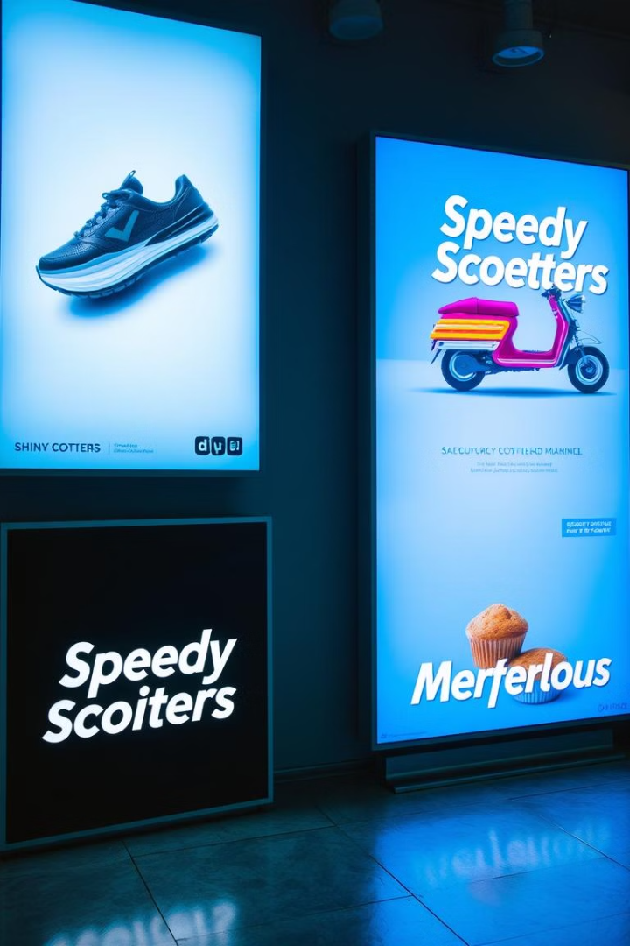



Alliteration in Advertising
Grab Attention
Memorable slogans stick.
Brand Recall
Easy to remember brand names.
Boost Sales
Effective marketing tool.

Slide 7

Alliteration in Tongue Twisters
1
2
3
Challenge
Fun
Educational
Tests articulation and speech skills.
Entertaining and playful.
Improves pronunciation and fluency.

Slide 8

Benefits of Using Alliteration
Improved Memory
Enhanced Creativity
Increased Engagement
Stronger Impact

Slide 9
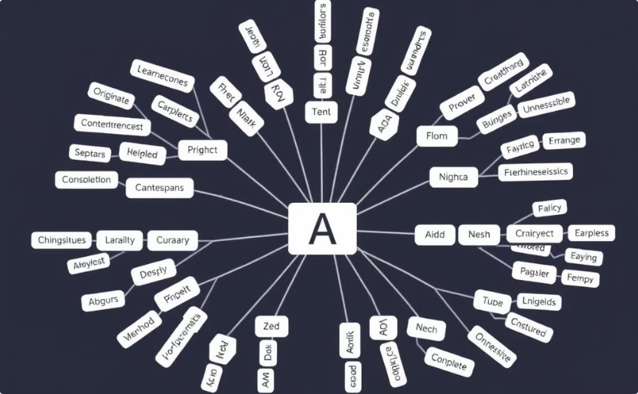
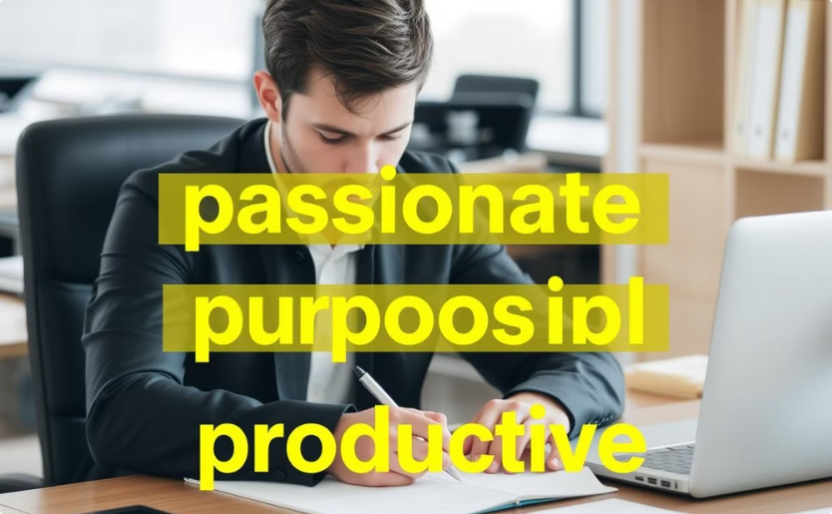
Crafting Effective Alliterative Phrases
Brainstorm
Refine
Generate ideas with repeating sounds.
Edit to ensure smooth flow and rhythm.

Slide 10
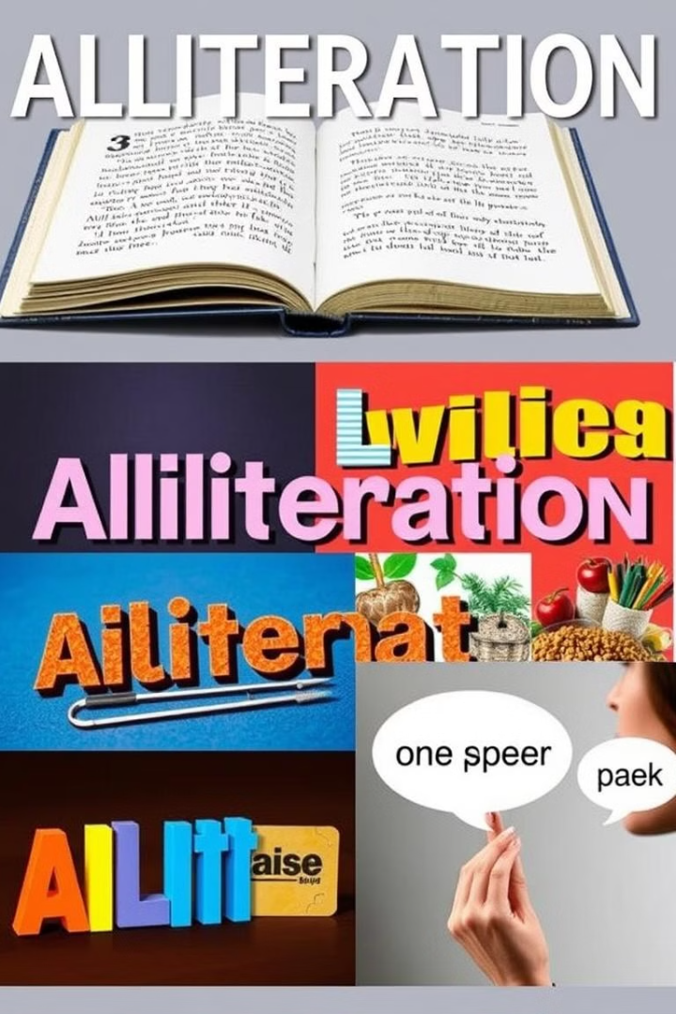
Alliteration in Action: Examples
Literature
Advertising
“Busy as a bee”
“Coca-Cola”
Tongue Twisters
“She sells seashells”

